Slide 1
Presentation
Jiayu Chen
2024.03.11

Slide 2
Work Description
Part_1: Template-based IBI Prediction
Part_2: BP-related Features of PPG
Part_3: Questions

Slide 3
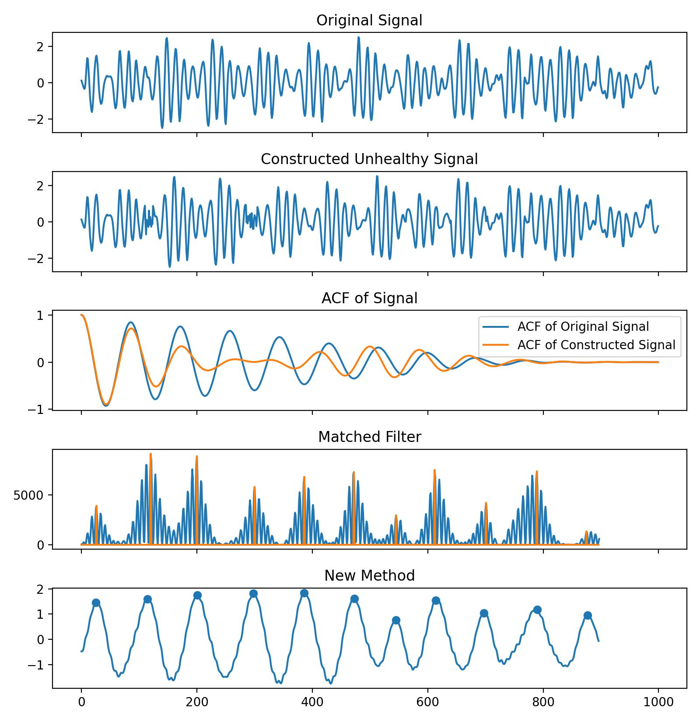
Template-based IBI Prediction
Conclusion:
The template-based approach is an effective tool for analyzing arrhythmia, advancing beyond models based on the assumption of the uniform heartbeat distribution.
Currently, a series of experiments have demonstrated its effectiveness. I believe that once the remaining issue is resolved, we can start writing the paper.
The ACF is dependent on the assumption of the uniform heartbeat distribution.

Slide 4
Template-based IBI Prediction
Experiment 1: HR Estimation
HR Estimation, MAE | Yingjian | New Method | Ratio
All_Back | 1.115 | 1.021 | -9.4%
CTRU_all_data_all_labels, Posture=0 | 1.984 | 2.000 | +0.8%
The dataset all_back is a well-filtered subset.
However, CTRU_all_data_all_labels was filtered using Yingjian's quality control method instead of more targeted methods, so the performance of the New Method could be further improved in the future.

Slide 5
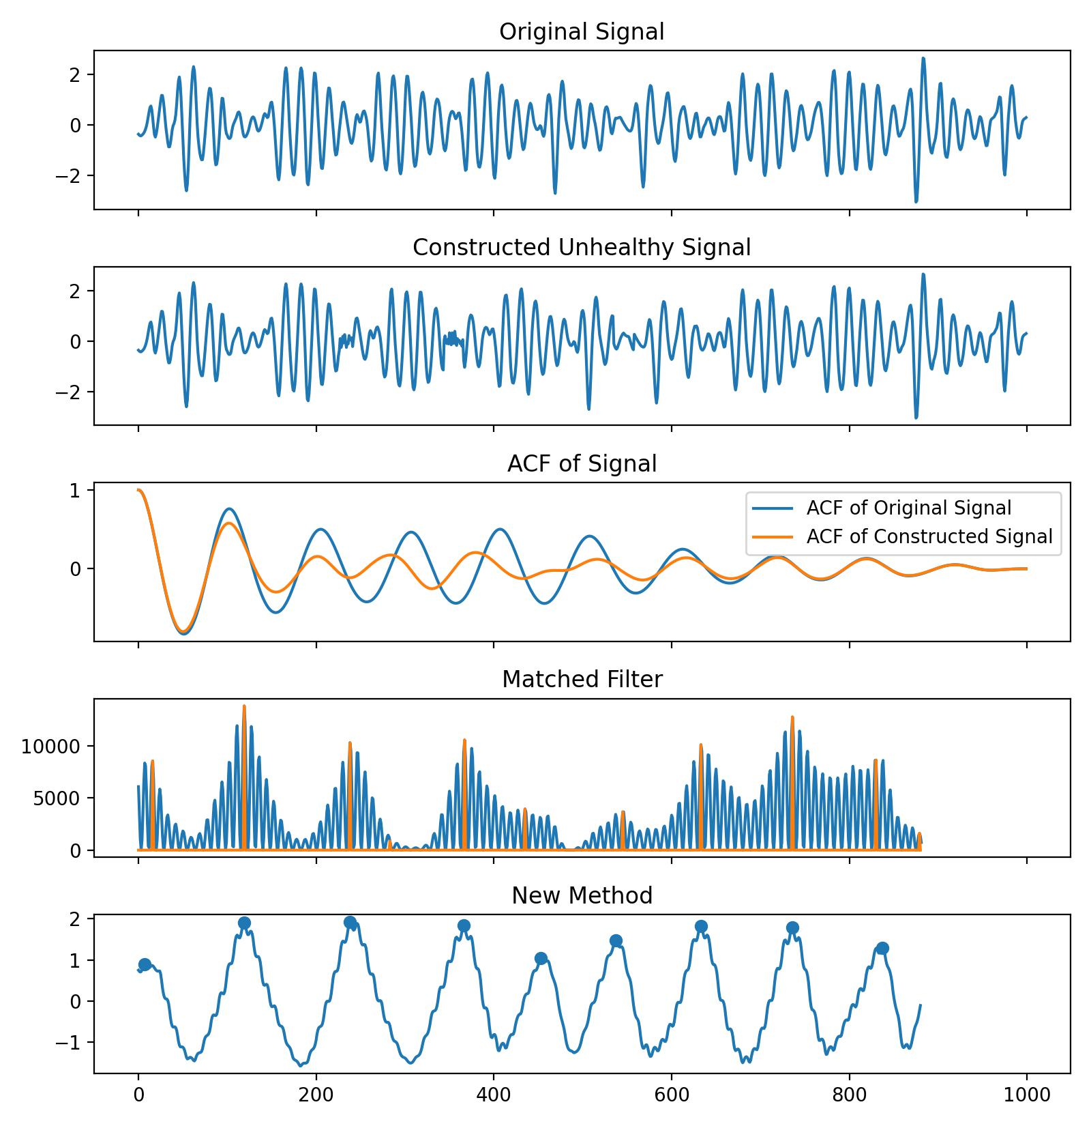
Template-based IBI Prediction
Experiment 2: Arrhythmia Classification
Confusion Matrix | Normal | Abnormal
Normal | 548 (17.31%) | 95 (3.00%)
Abnormal | 3 (0.1%) | 2519 (79.59%)
A 10-second BSG signal can construct a dataset of heart rate anomalies while ensuring a constant heart rate.
The ratio of normal heart rate signals to abnormal heart rate signals in the simulated dataset is approximately 1:4.

Slide 6
Template-based IBI Prediction
Experiment 3
HR Estimation, MAE | Yingjian | New Method | Ratio
All Back(all) | 1.115 | 1.021 | -9.4%
All Back(healthy) | 1.034 | 0.970 | -6.4%
All Back(arrhythmia) | 1.851 | 2.083 | -
Using the classification algo from Experiment 2, the dataset was divided into 2 parts: normal heart rate signals and signals classified as abnormal heart rates.
The New Method performs better on healthy signals. Further explanation will be provided regarding results on arrhythmia data.

Slide 7
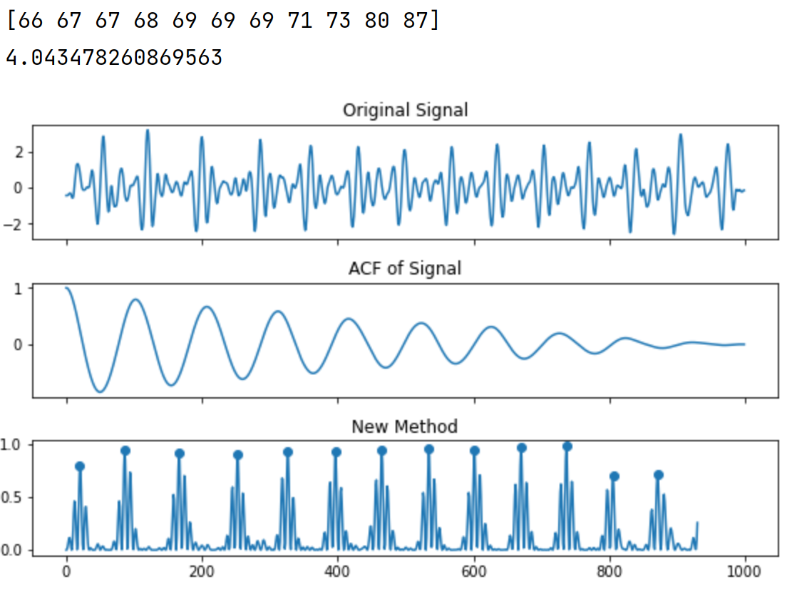
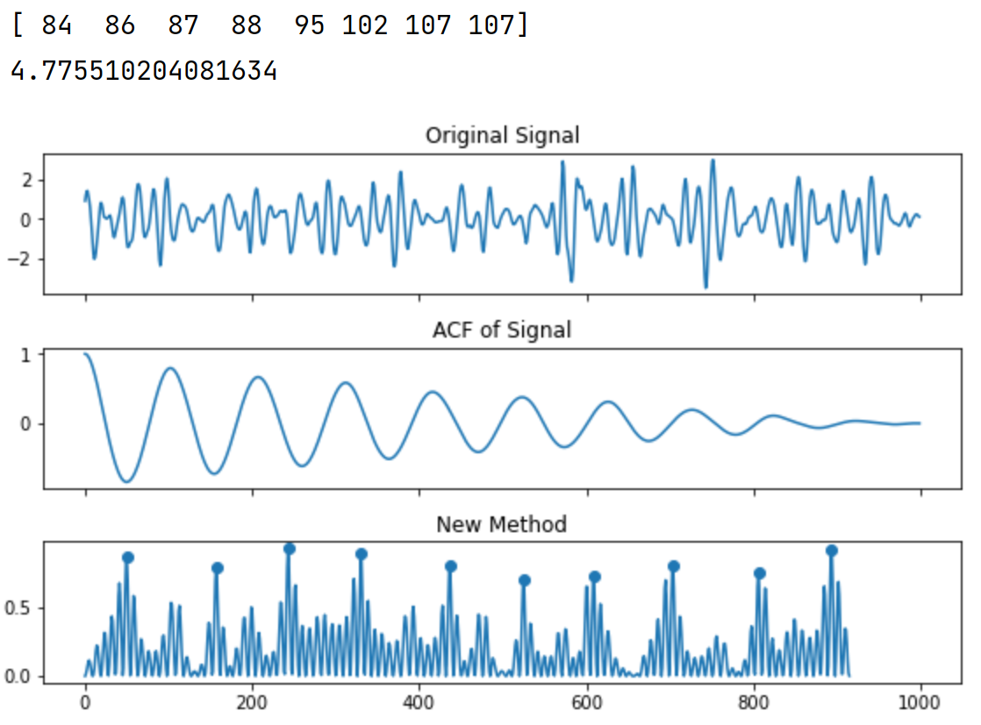
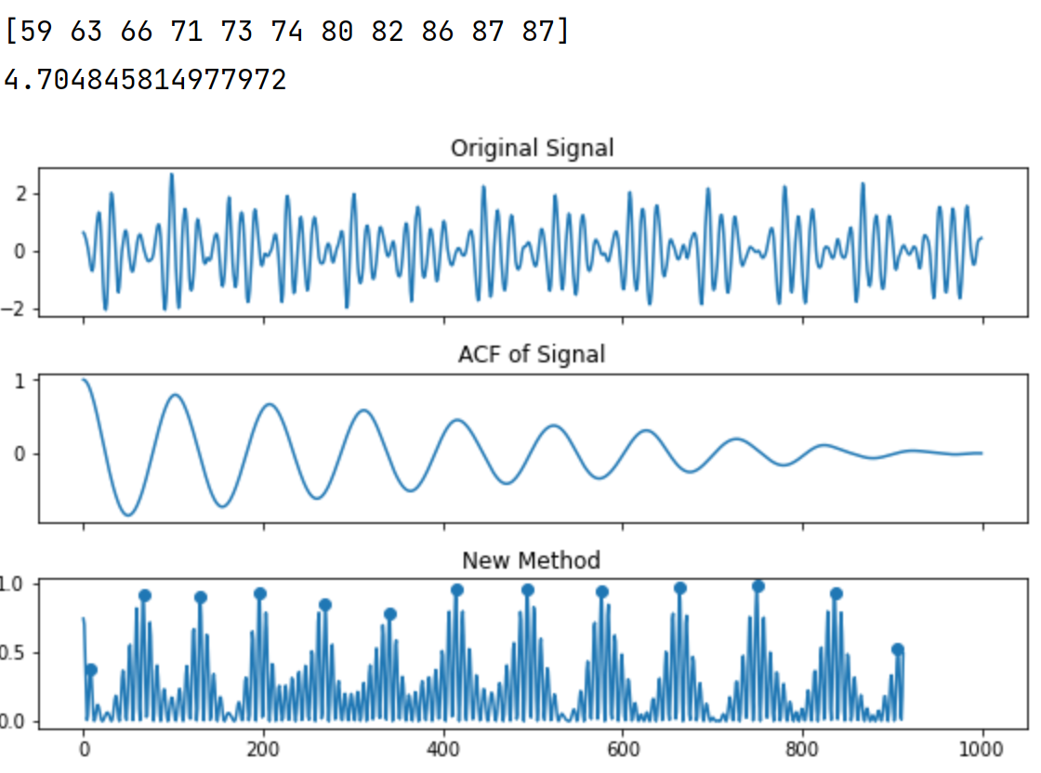
Template-based IBI Prediction
On arrhythmia data heartbeats are well detected, but the MAE of HR is quite large.
HR_estimated = 60*sampling_rate/median(IBIs)

Slide 8
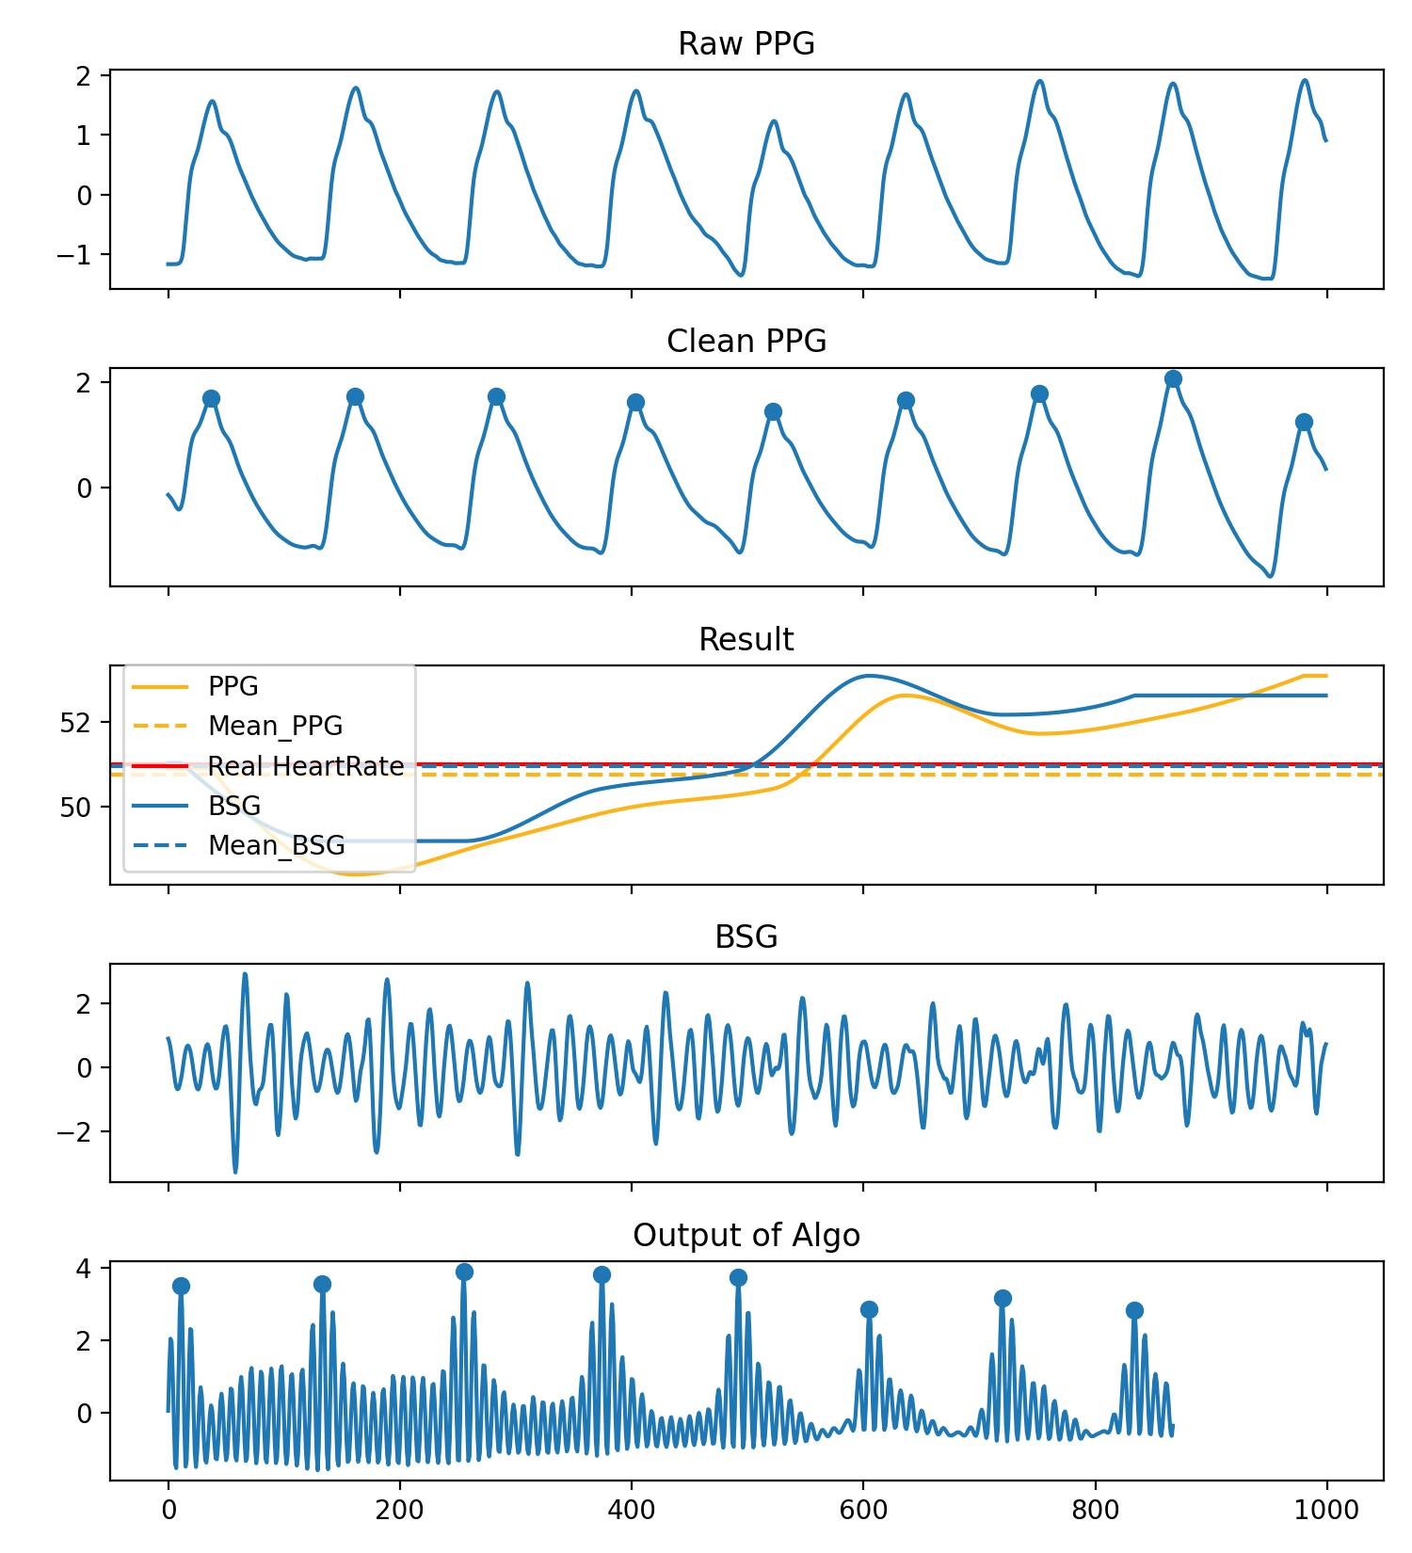
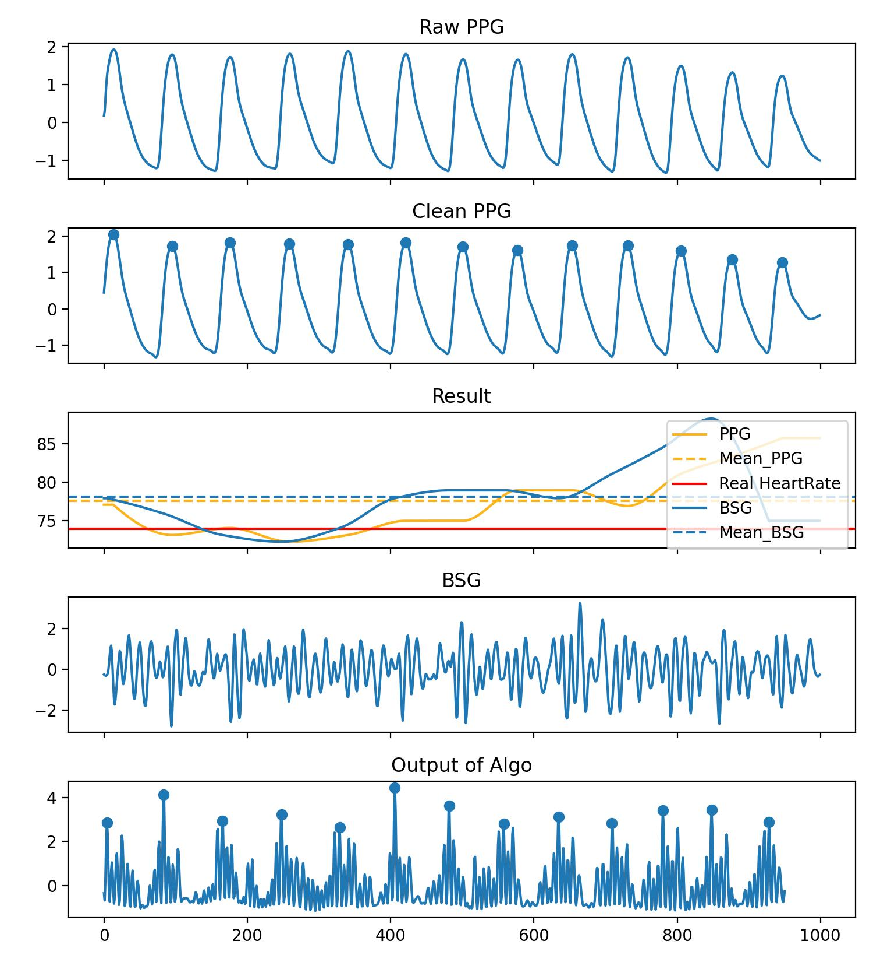
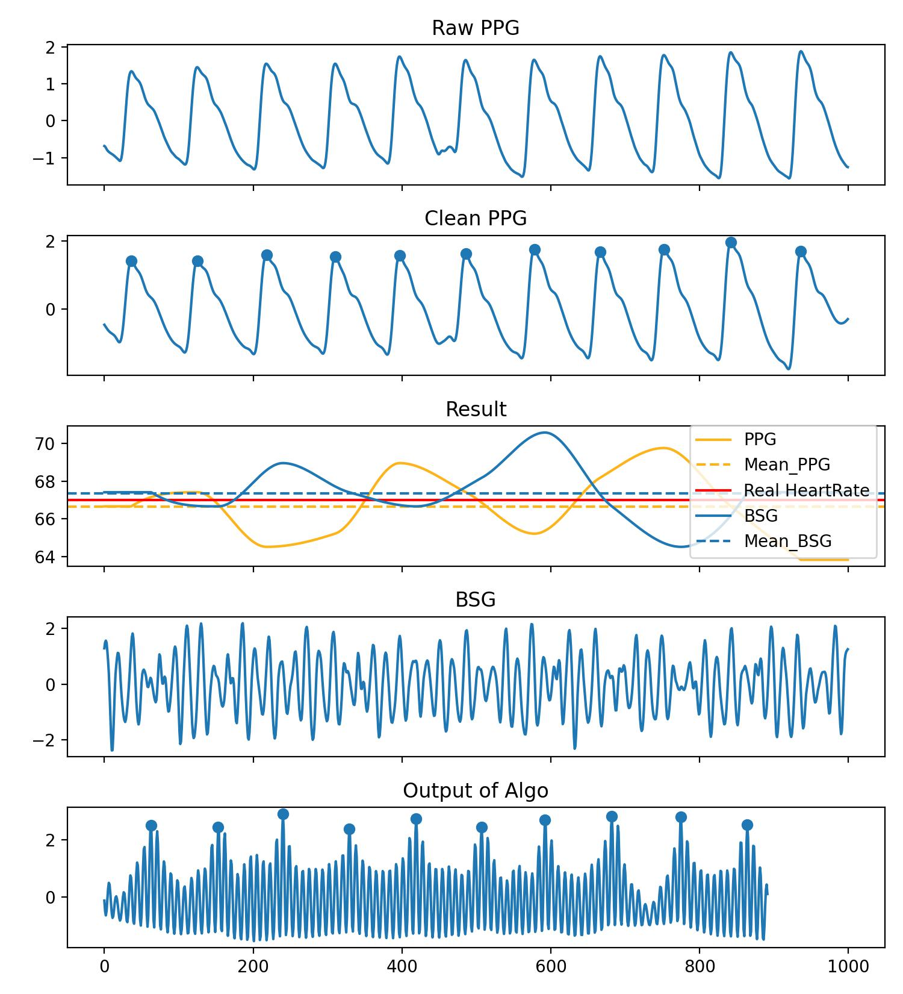
Template-based IBI Prediction
Experiment 4: IBI Prediction
The IBI calculated from PPG and BSG signals does not strictly correspond, so currently, visualization is used to display the results. The results mainly consist of 4 categories.
Category 1: The trends are consistent.

Slide 9
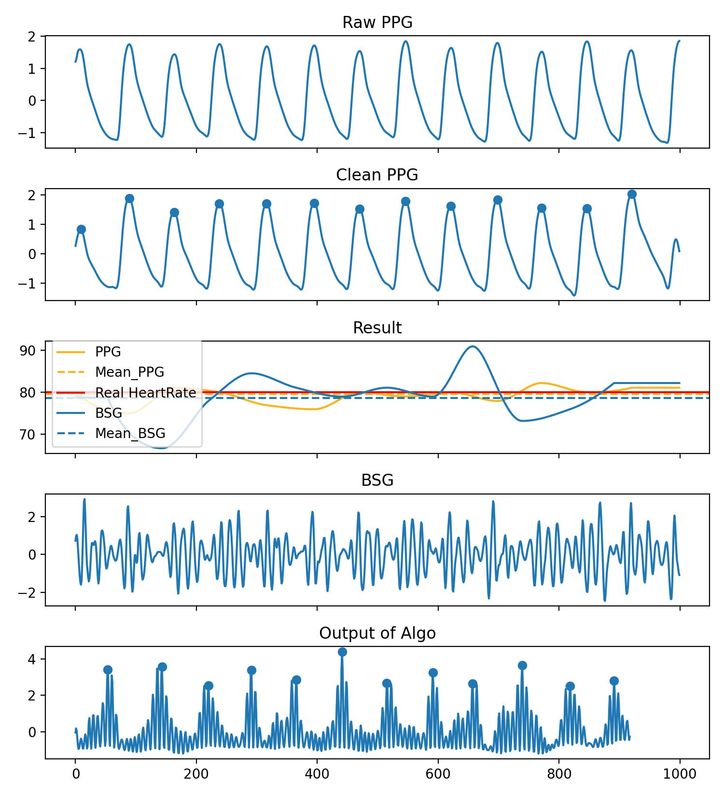
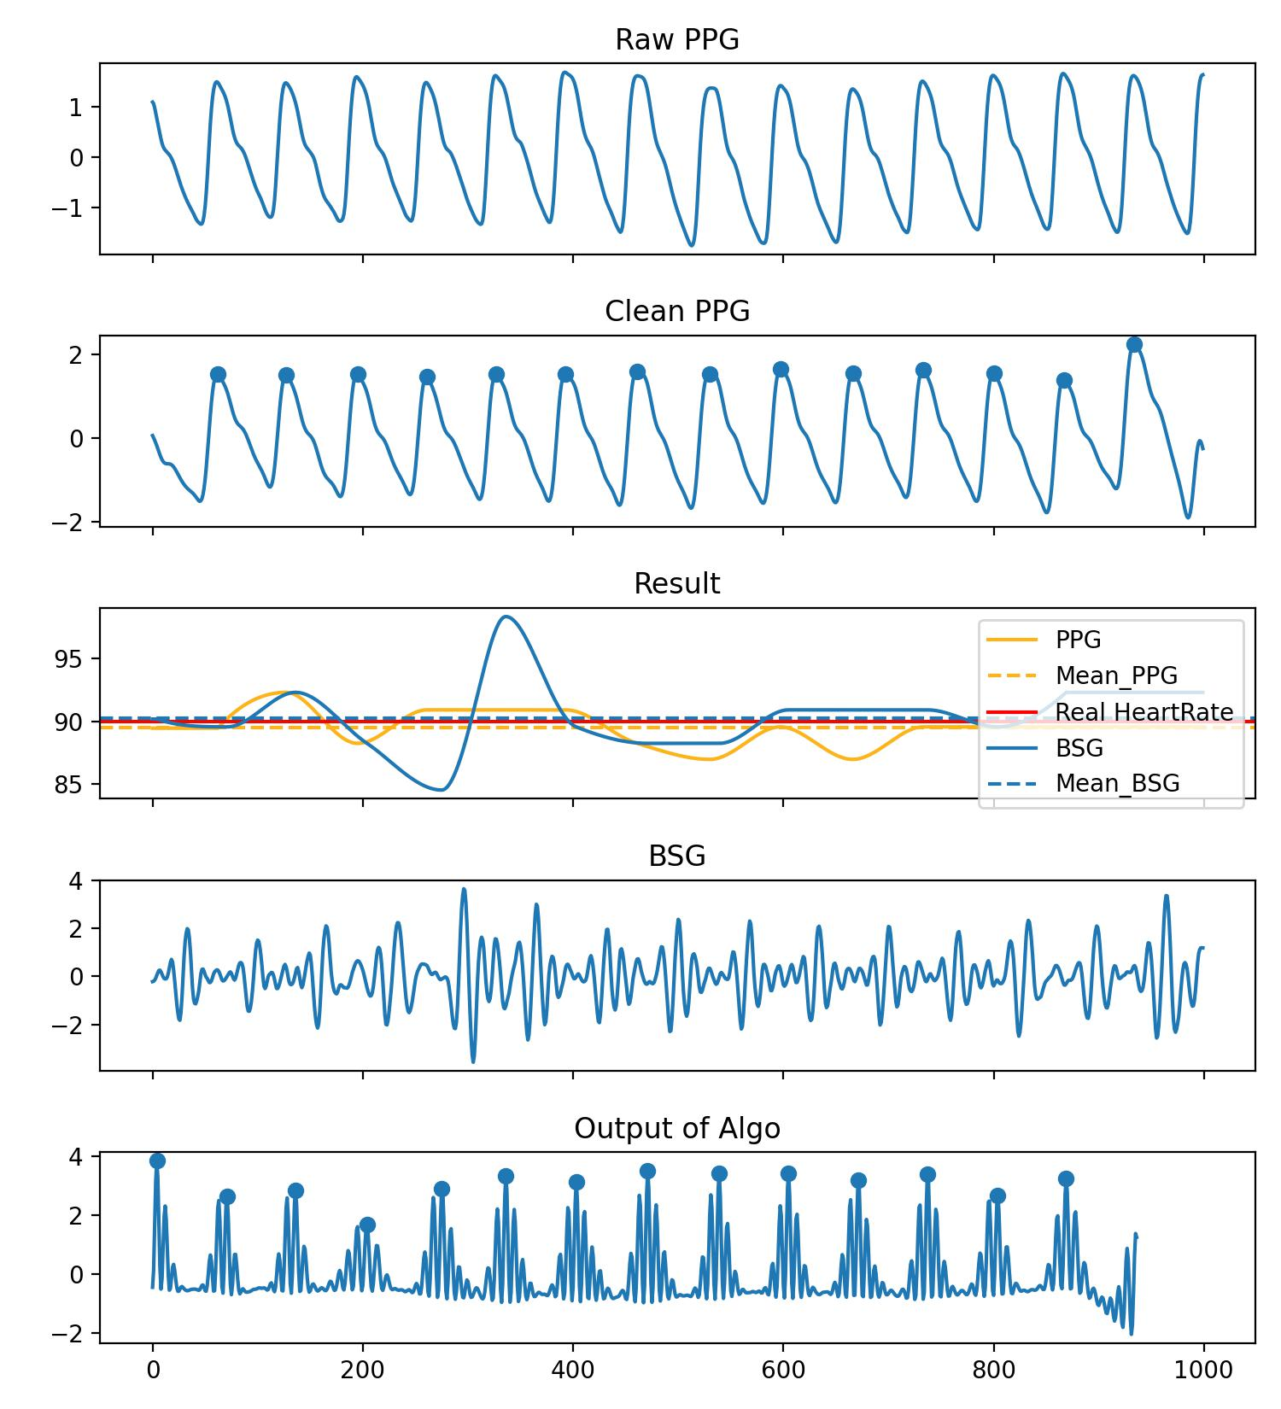
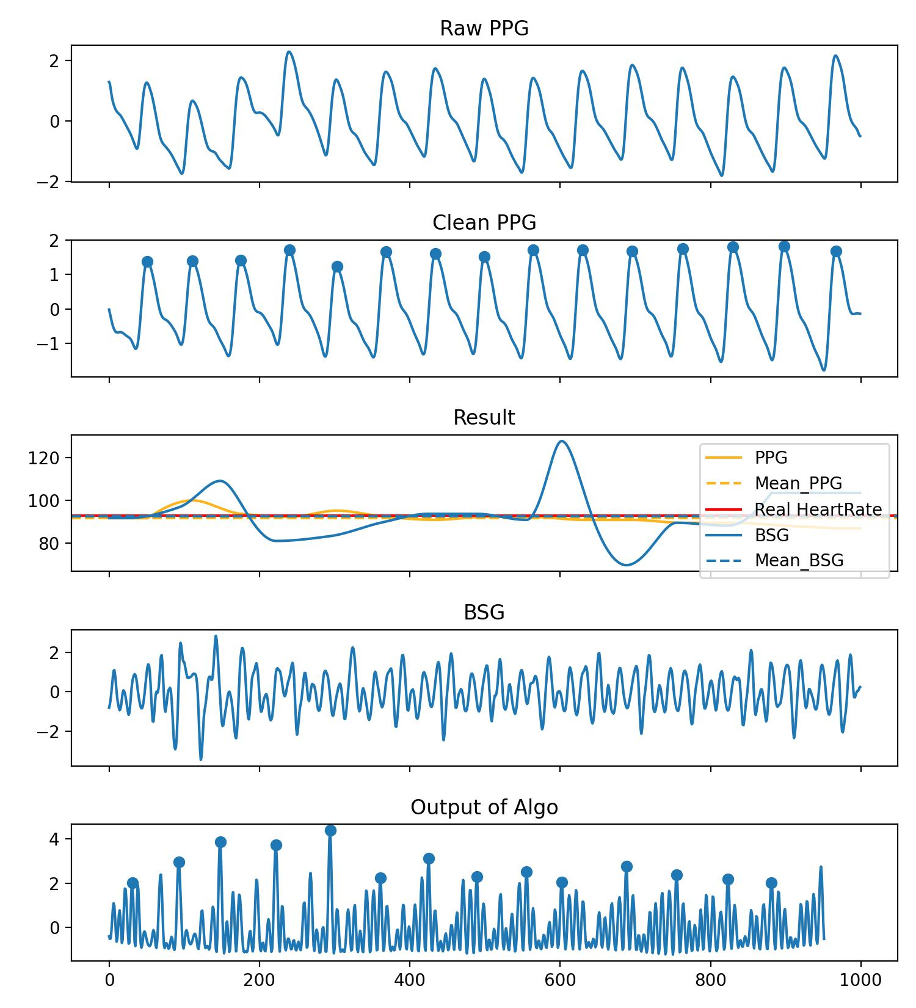
Template-based IBI Prediction
Category 2: The trend doesn't match, but estimated heart rate error is quite small.

Slide 10
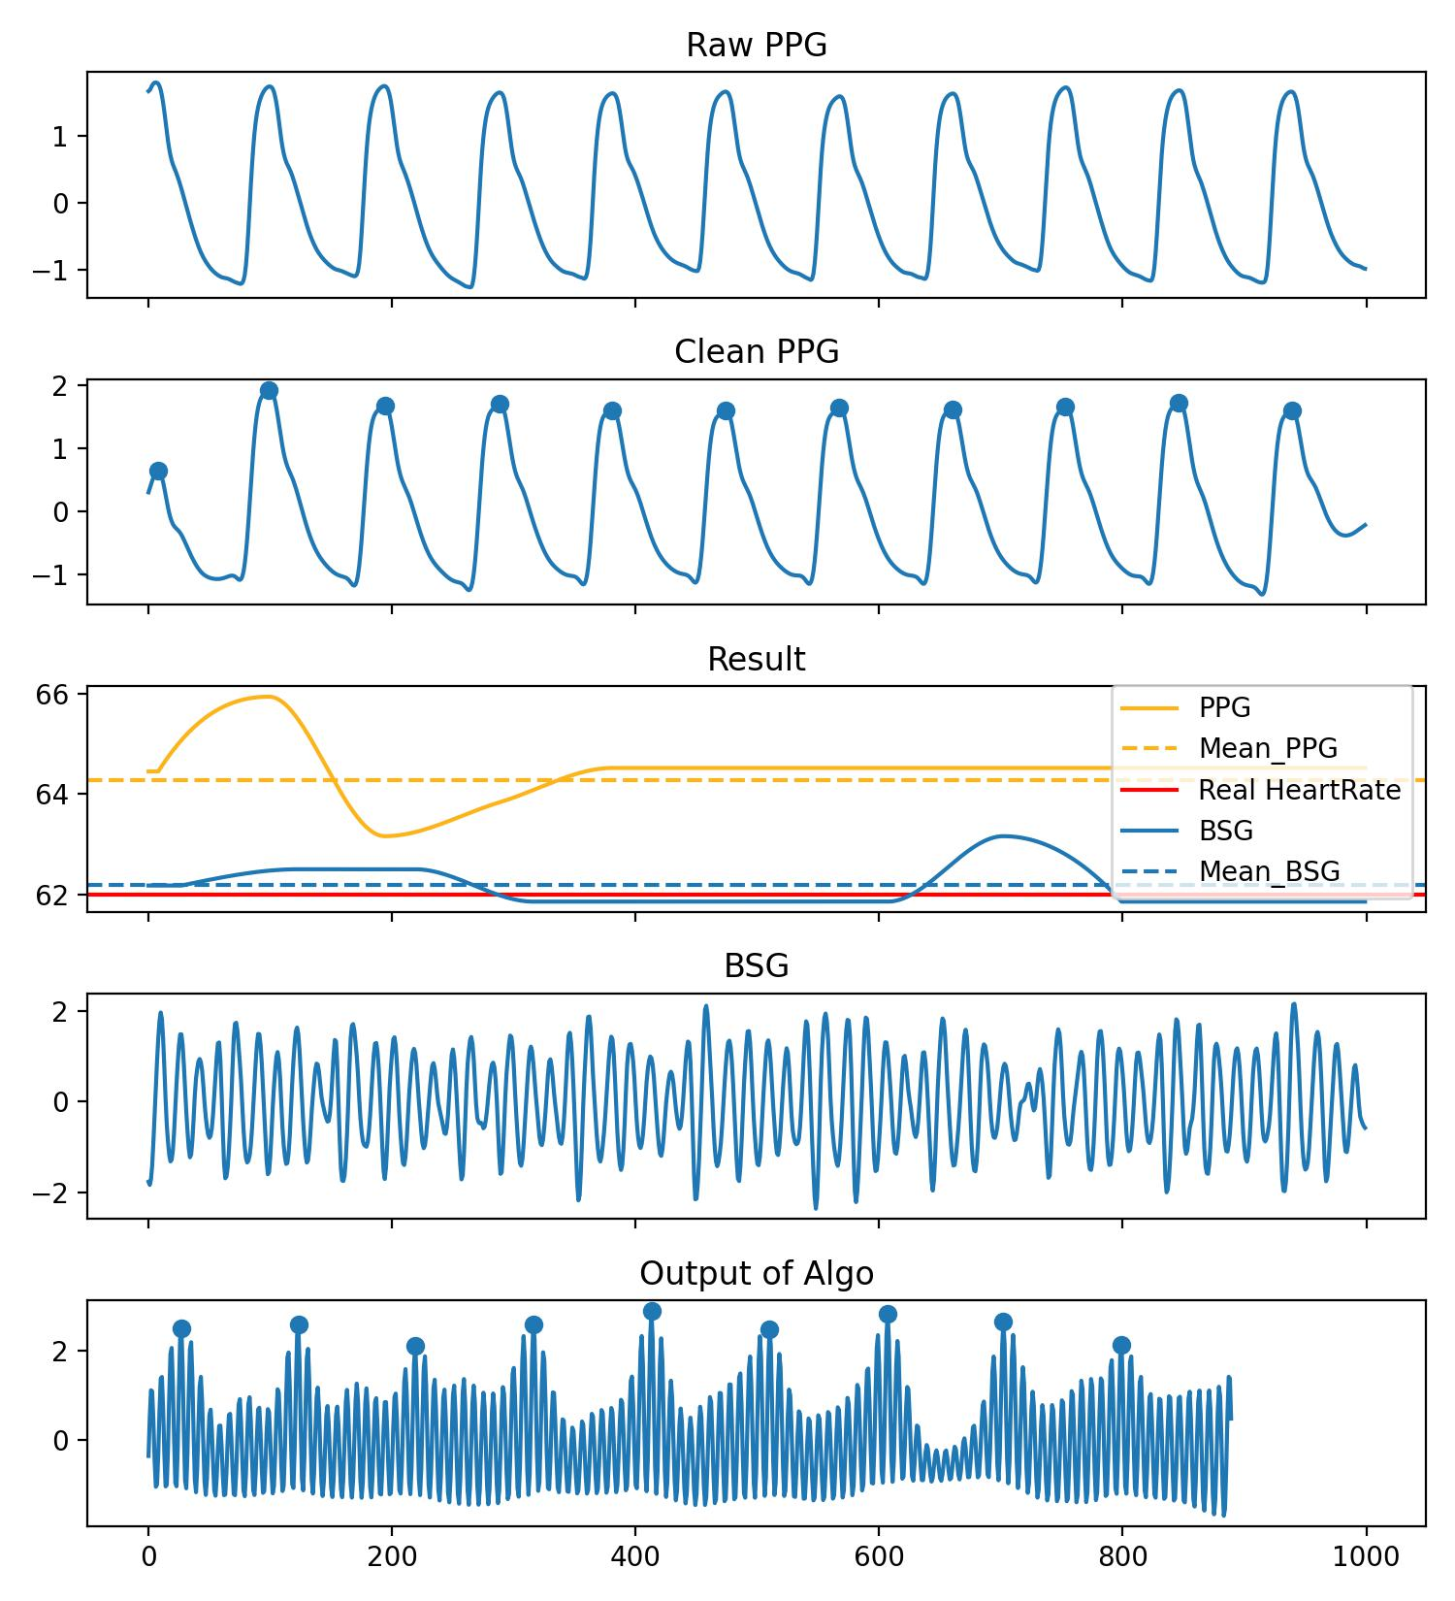
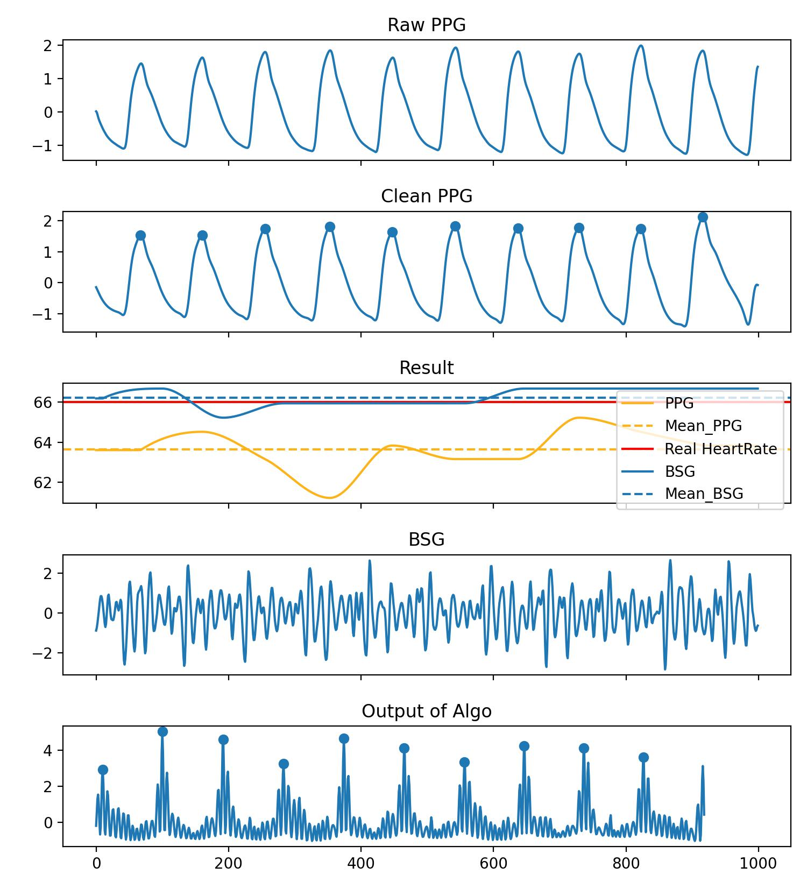
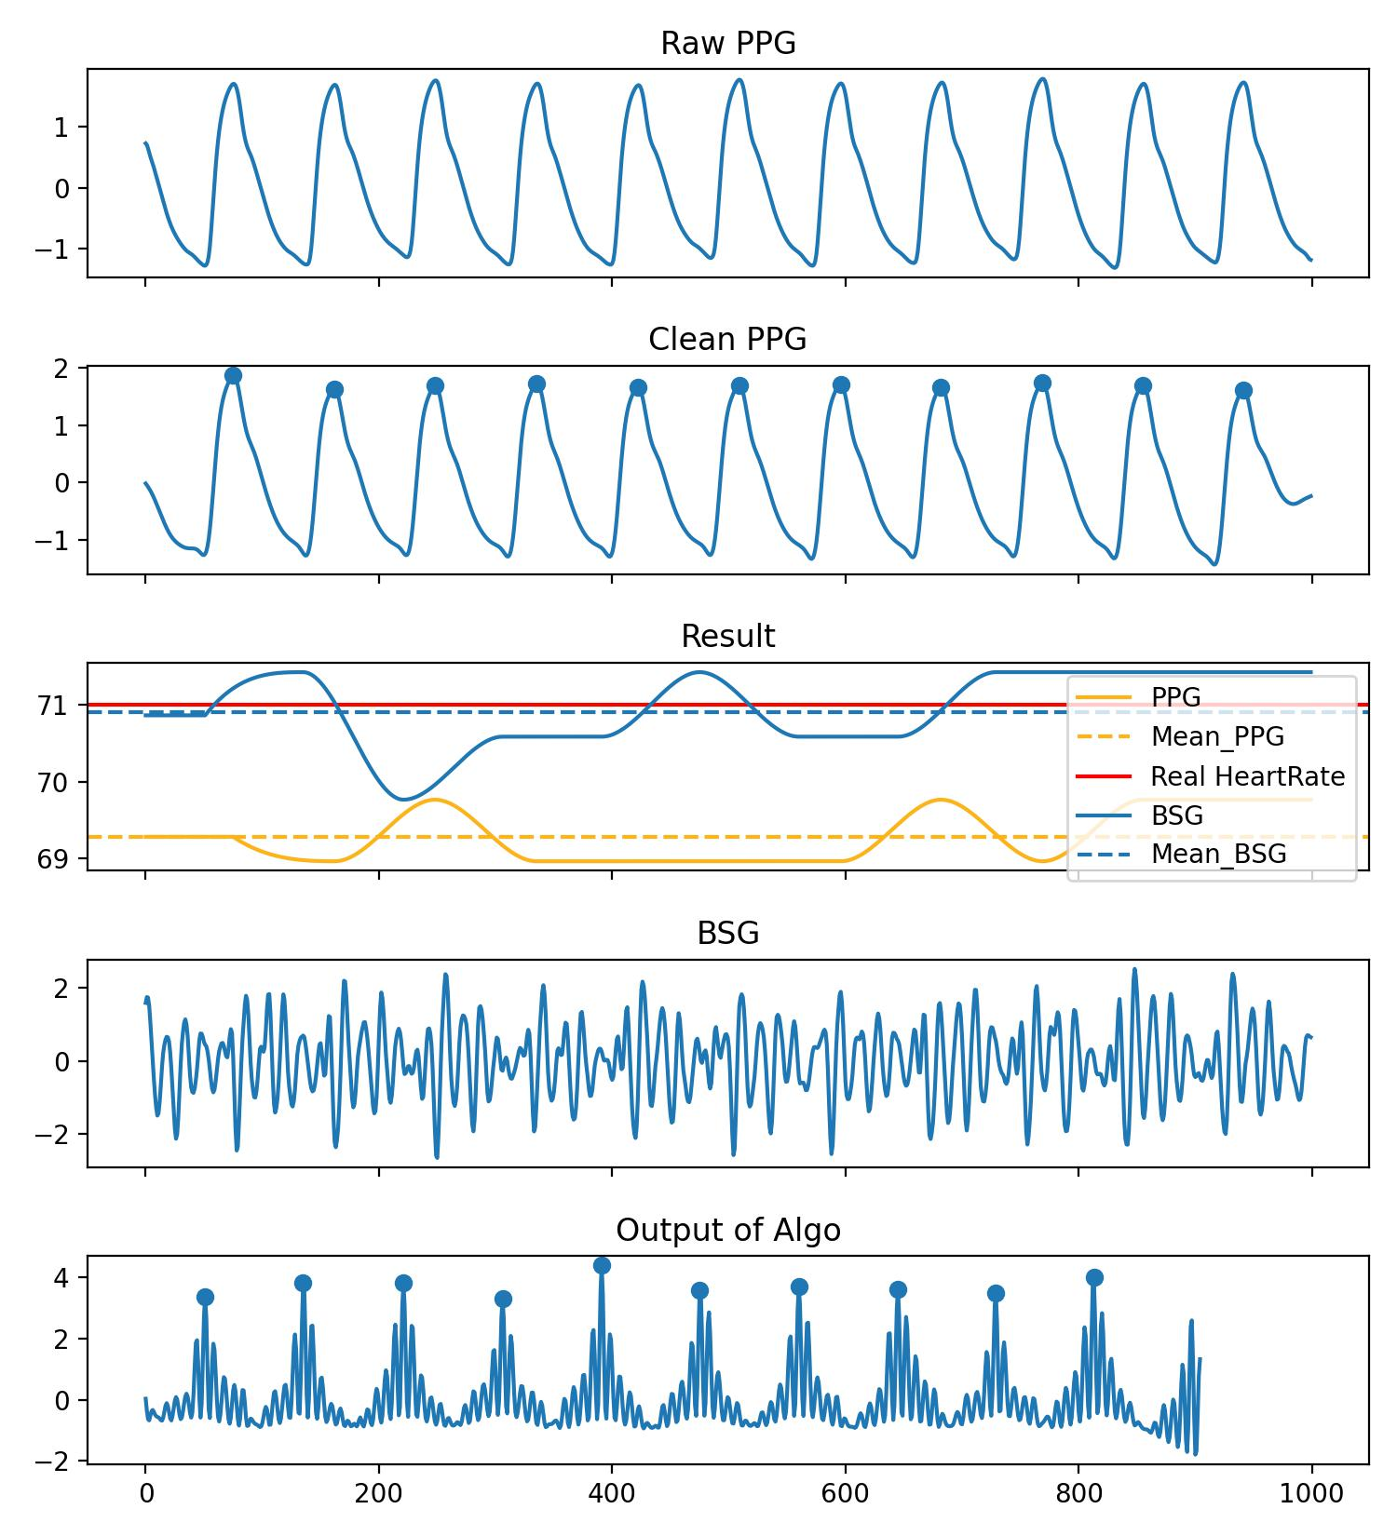
Template-based IBI Prediction
Category 3: It seems that the error in PPG is larger.

Slide 11
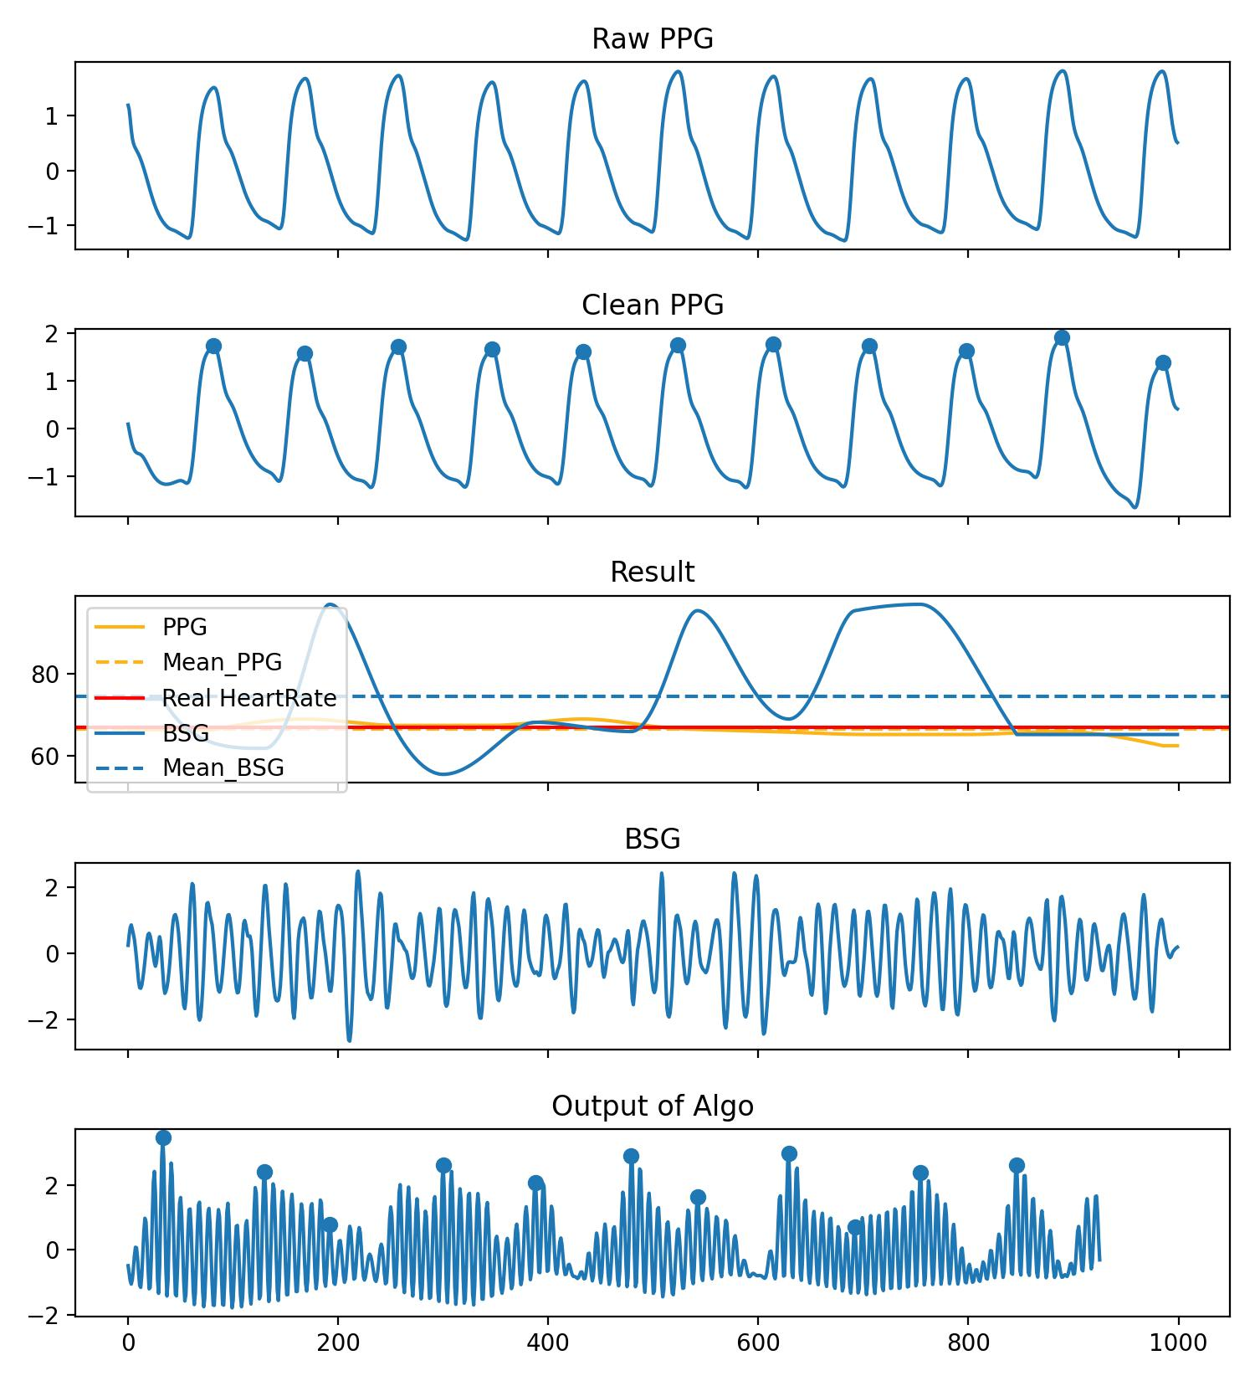
Template-based IBI Prediction
Category 4: Quality control of BSG signals needs to be improved.
Conclusion of Experiment 4:
PPG is sometimes not entirely reliable, and there is a phase shift between PPG and BSG. Using IBI obtained from PPG as labels seems inappropriate.
There is a significant difference between HR prediction and IBI prediction in the 10-second signal, indicating the need for stricter quality control to ensure accuracy of each heartbeat interval.

Slide 12
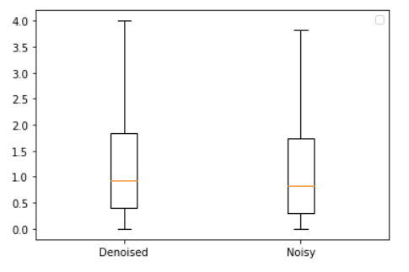
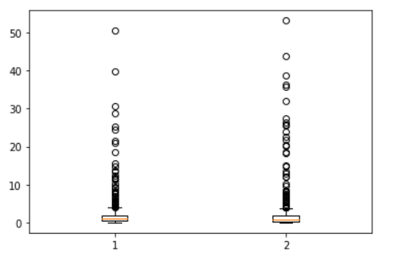
Template-based IBI Prediction
Experiment 5
Quality control is necessary, but denoising is not essential. Most noise is unrelated, and some noise can actually help us match more accurately.
MAE of HR
MAE of HR
Denoised Noisy
Denoised Noisy

Slide 13
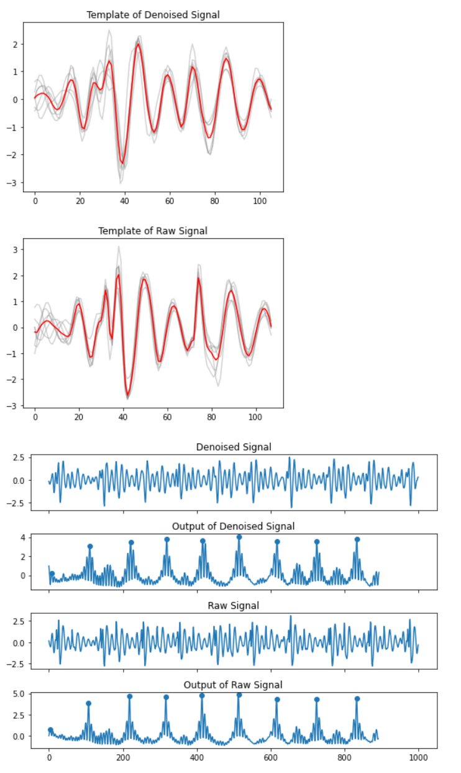
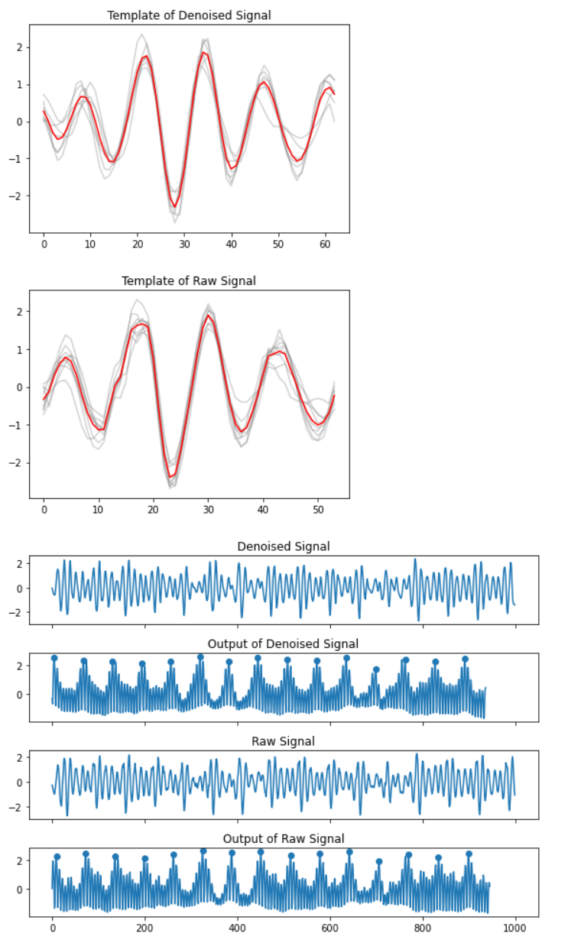
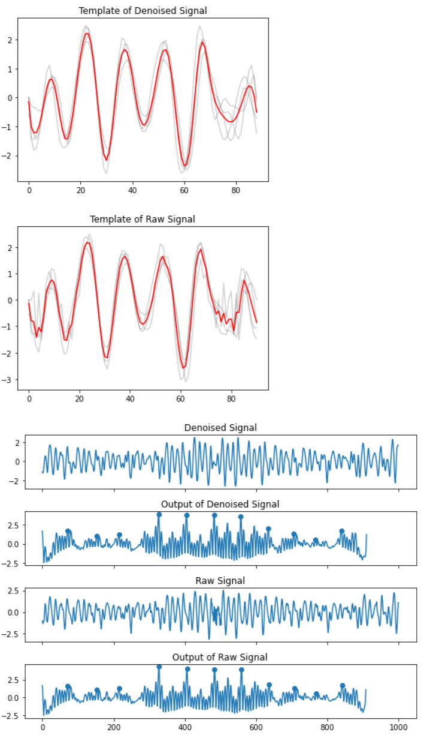
Template-based IBI Prediction

Slide 14
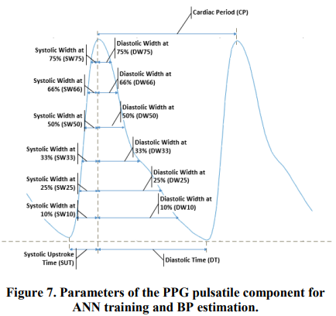
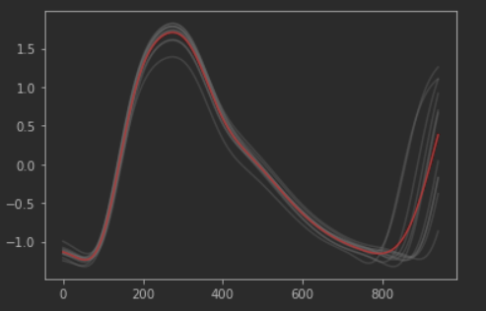
BP-related Features of PPG
Model | S (Real/Paper) | D (Real/Paper)
LR | 15.737/12.224 | 8.495/9.204
SVR | 14.905/11.6415 | 7.869/7.617
Template-based Feature Extraction
Reference: Zhang Y, Feng Z. A SVM method for continuous blood pressure estimation from a PPG signal[C]//Proceedings of the 9th international conference on machine learning and computing. 2017: 128-132.

Slide 15
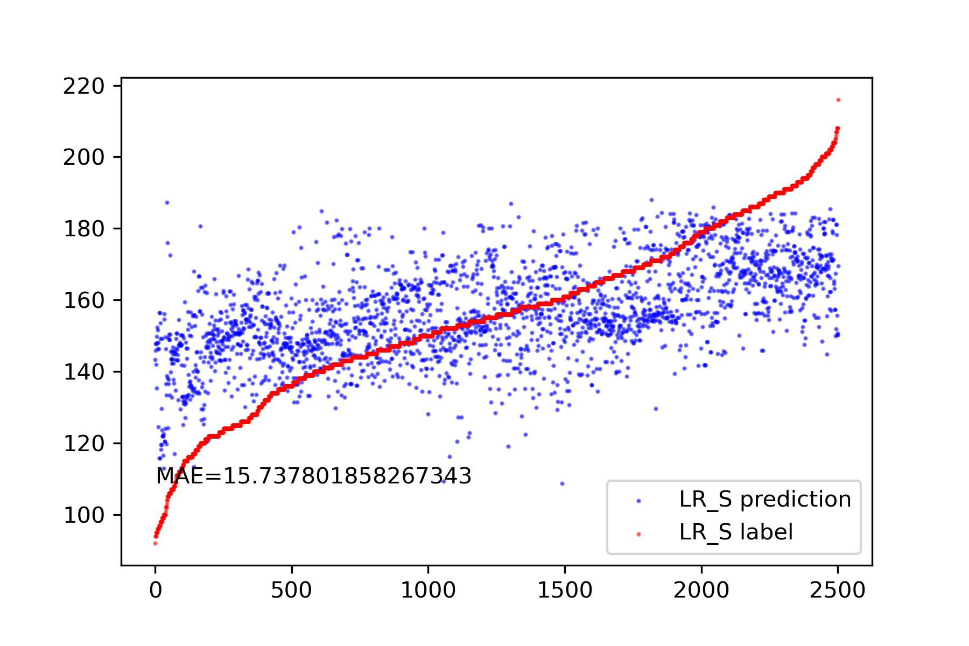
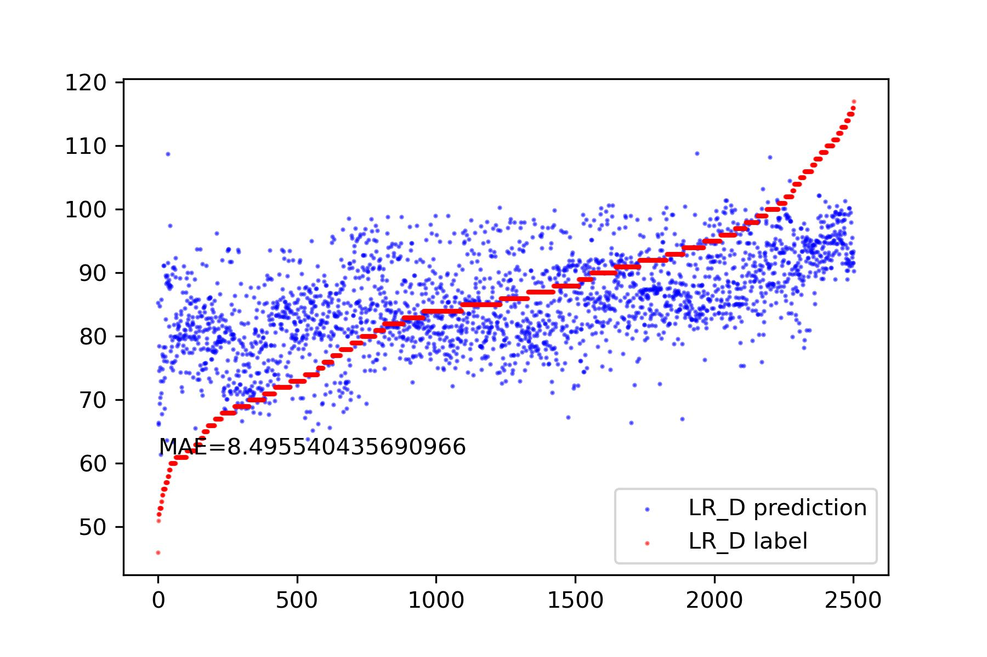
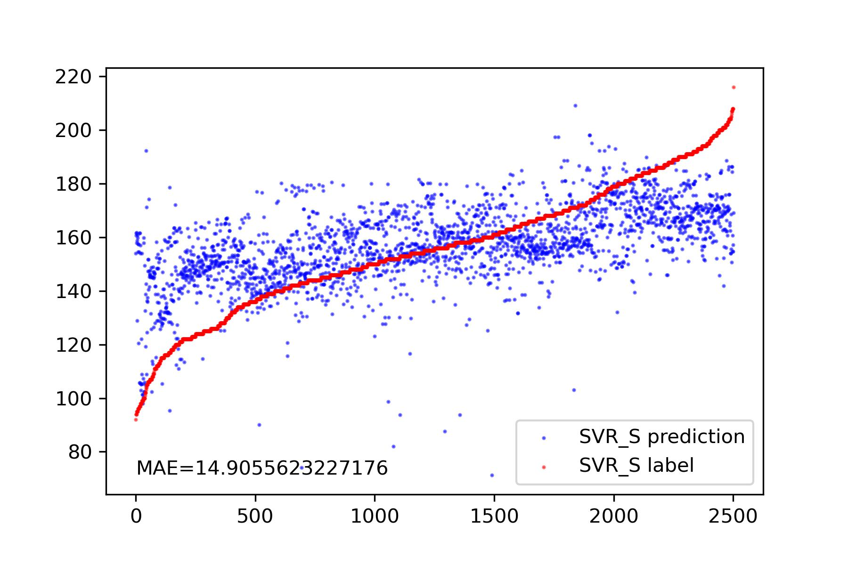
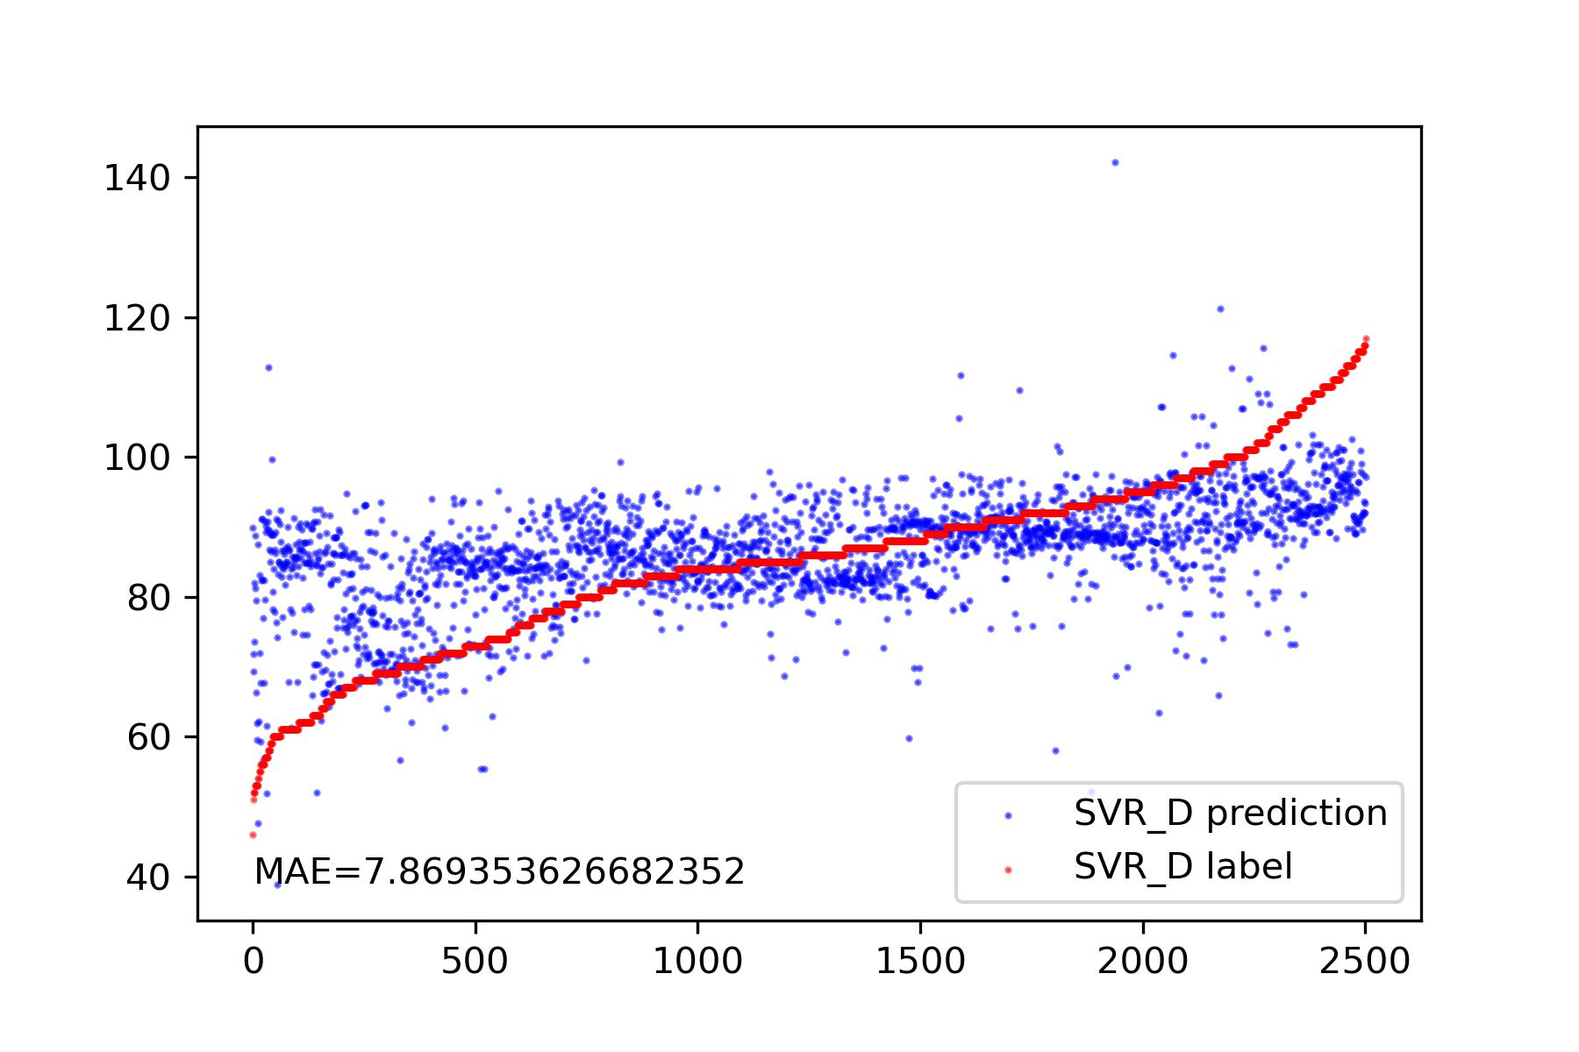
BP-related Features of PPG

Slide 16
Thanks!

